Slide 1
DHCP:Dynamic Host configuration Protocol

Slide 2
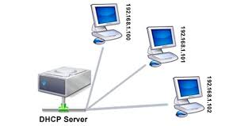
Installation and configuration of DHCP Server Installation of SW on remote system

Slide 3
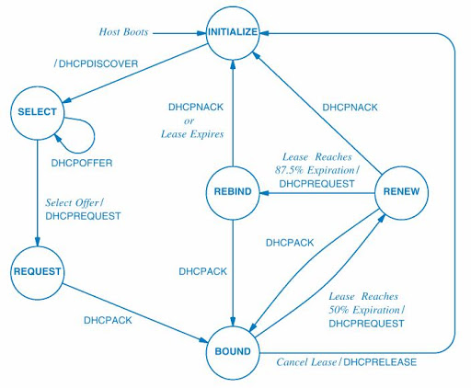
State diagram(Client)

Slide 4
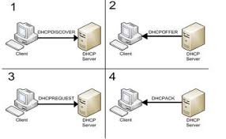

Slide 5
Steps at server side
Su
Yum install dhcp
Vi /etc/dhcp/dhcpd.conf
Press Insert key
Update the conf file
Press "ESC" then press" :" then type wq
Systemctl start dhcpd.service
Stsemctl enable dhcpd.service

Slide 6
Client side
Change the network setting to obtain IP automatic (DHCP)
Make ethernet interface ON/OFF
Type ifconfig to see the assigned IP

Slide 7
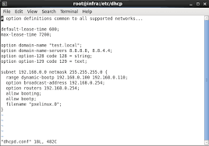
/etc/dhcp/dhcpd.conf

Slide 8
Sample conf file
subnet 192.5.5.0 netmask 255.255.255.224 { range 192.5.5.26 192.5.5.30; option name-servers www.pict.edu; option domain-name "pict.edu"; option routers 192.5.5.1; option subnet-mask 255.255.255.224; option broadcast-address 192.5.5.31; default-lease-time 600; max-lease-time 7200; }

Slide 9
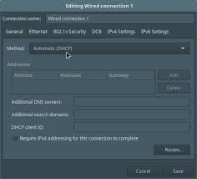

Slide 10
Check the assigned IP-MAC mapping in file
Vi /var/lib/dhcp/dhcpd.leases

